Slide 1
Data Analysis Project: Sales Data Analysis Using Python
Ramakrishnan CL
19/02/2024

Slide 2
Introduction
A brief overview
This project focuses on analyzing sales data from three branches of a company. The aim is to understand customer purchasing behaviour, identify popular product categories, and uncover any trends or patterns in sales. By examining factors such as categories, quantity sold, and total sales, we hope to provide valuable insights that can help the company make informed decisions to improve its sales strategy and enhance customer satisfaction.
Objectives and goals of the project
Understand customer behavior based on sales data.
Identify the most popular product categories and payment type.
Analyze trends and patterns in sales over time.
Provide actionable insights to improve the company's sales strategy.
Enhance profit through informed decision-making.

Slide 3
Description of the Dataset
The dataset used in the analysis consists of sales data from three different branches of a company in one year (1/1/2022 to 31/12/2022.) It includes several fields or columns such as "Invoice ID," "Branch," "City," "Gender," "Category," "Unit price," "Quantity," "Total," and "Payment Type." Each row in the dataset represents a unique sales transaction, and the columns contain information about various aspects of each transaction, such as the branch location, product category, number of units, pricing, and payment type.
Source of the Data:
The dataset was sourced from Kaggle, a popular platform for hosting datasets and machine learning competitions. Kaggle provides a wide range of datasets contributed by the community, making it a valuable resource for data analysis projects.
Key Variables and Their Definitions:
Branches: The dataset contains sales data from three branches located in Chennai, Bangalore, and Mumbai.
Unit Price: This variable represents the price of each unit of the product in Indian Rupees (INR).
Total: The total amount of the sales transaction in Indian Rupees (INR).
Payment Types: The dataset includes three types of payment methods: Ewallet, Cash, and Credit card. These variables indicate how customers made payments for their purchases.

Slide 4
Steps in Data Analysis
Data Cleaning and Preparation:
Identified and handled missing or null values.
Remove duplicates, if any.
Standardize data formats and values.
Correct any inconsistencies or errors in the dataset.
Only the relevant columns are chosen for analysis.
Loading Data into Jupyter Notebook:
Imported necessary libraries such as pandas for data manipulation and matplotlib for data visualization.
Loaded the cleaned dataset into a pandas DataFrame within Jupyter Notebook.
Quantitative Analysis:
Calculated total sales, total sales per branch, % of sum contributed by each category, etc.
Performed group-wise analysis (e.g., sales by branch, gender, category).
Data Visualization:
Created visualizations such as histograms, bar charts, line plots, scatter plots, etc., to explore data distributions and relationships.
Deriving Insights:
Interpreted the results of quantitative analysis and data visualizations.
Identified trends, patterns, outliers, and any significant findings.
Drawn conclusions and insights based on the analysis.
Communicated findings effectively in the project report.

Slide 5
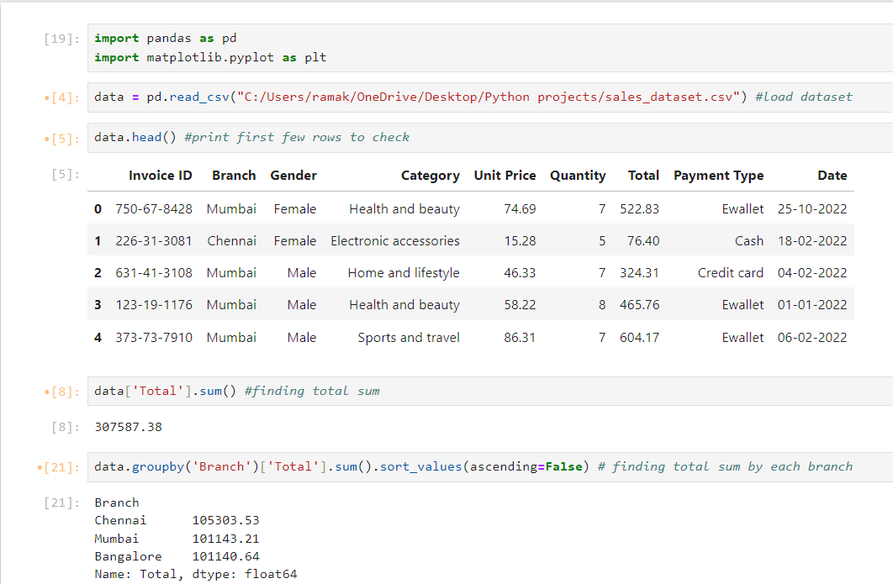
Jupyter Notebook Snapshots

Slide 6
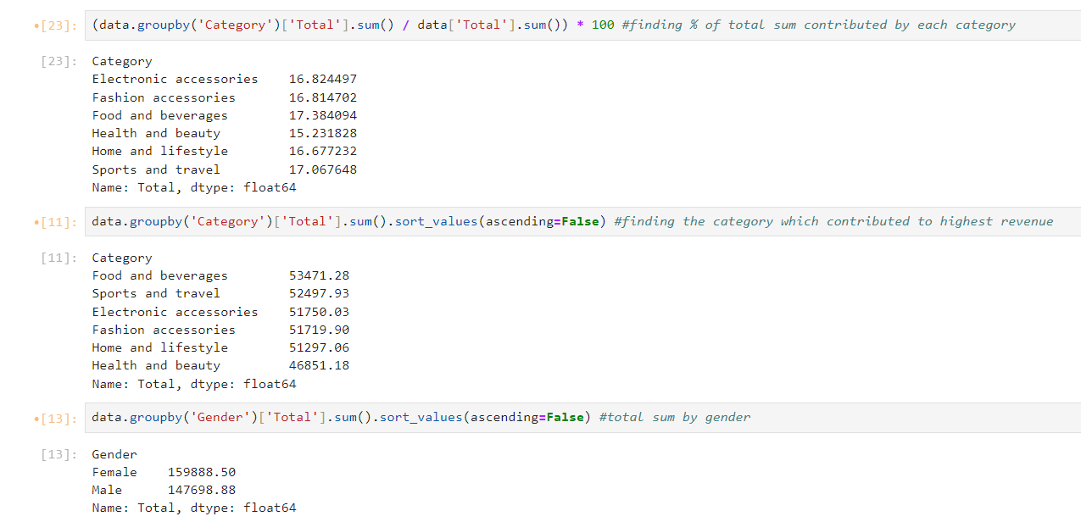
Jupyter Notebook Snapshots

Slide 7
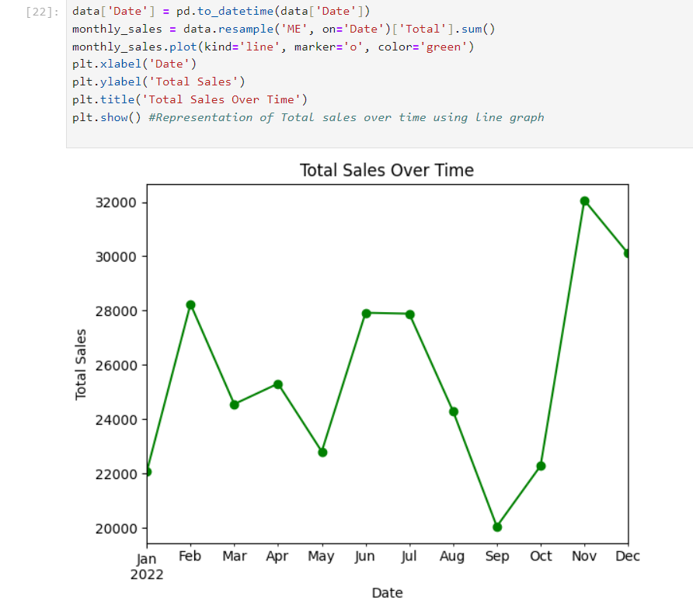
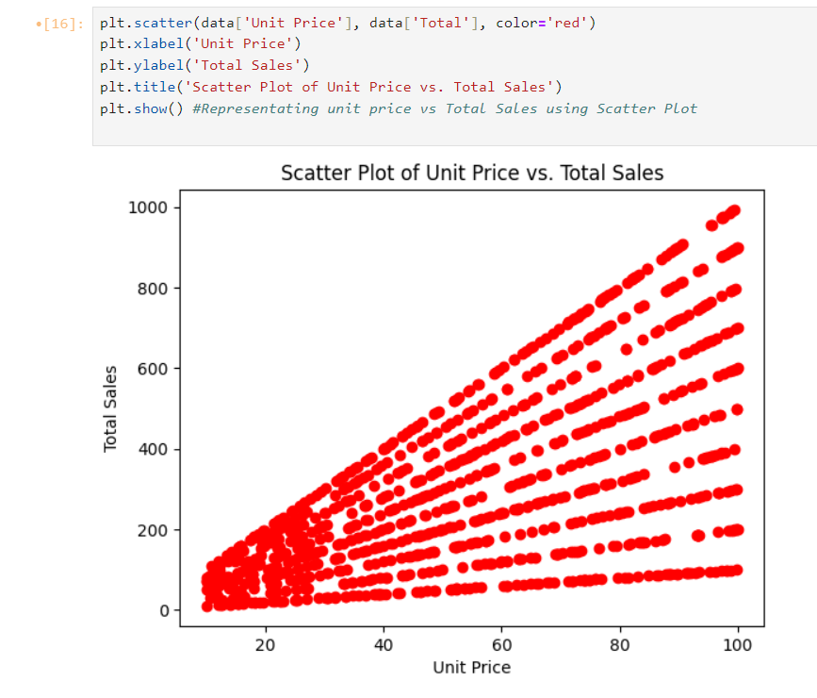
Data Visualization

Slide 8

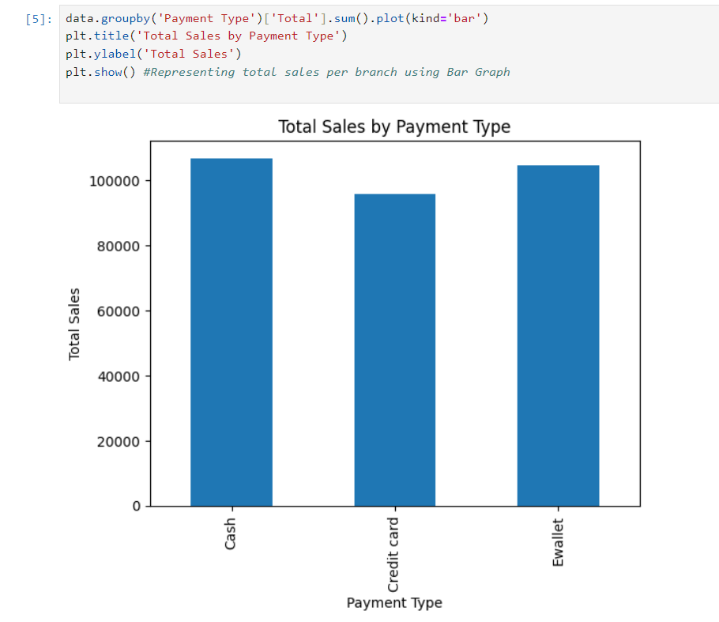
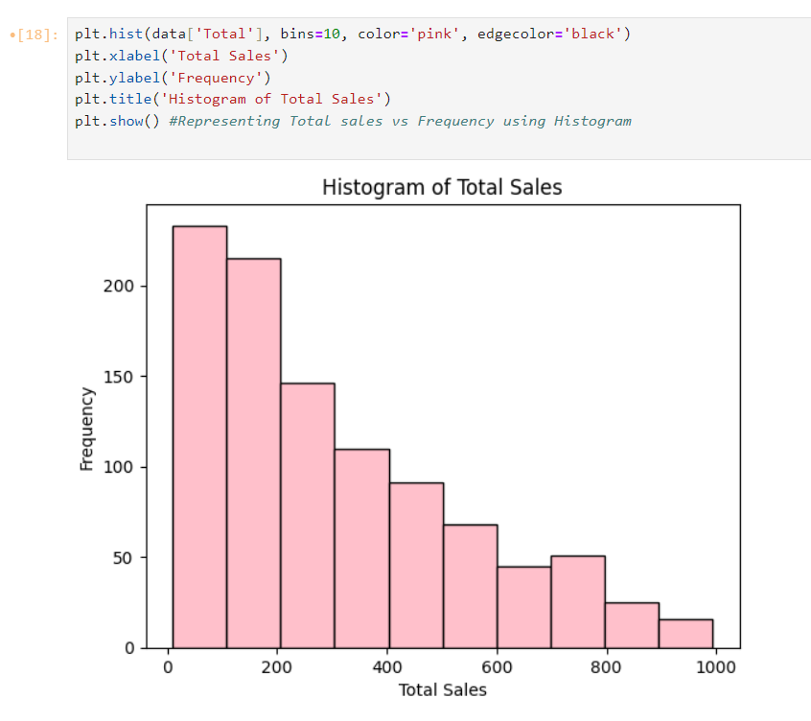

Slide 9
Conclusion
In conclusion, our analysis of the sales dataset from three branches of the company has provided valuable insights into customer behavior, product popularity, and sales trends. Through meticulous data cleaning, thorough quantitative analysis, and insightful data visualizations, we have uncovered several key findings:
Total revenue obtained in 1 year from the sample dataset = ₹307587.38
The branch in Chennai contributed to the highest revenue (₹105303.53), followed by the branch in Mumbai (₹101143.21) and Bangalore (₹101140.64.)
The food and beverage section contributed to the highest revenue (₹53471.28) while the health and beauty section contributed the least (₹46851.18.)
Female customers contributed more to the revenue than males.
The graph of total sales over time shows that the highest sales happened in November and the lowest sales happened in September.
The scatter plot of Unit Price vs Total Sales indicates that there is a positive correlation. ie, as the unit price increases, total sales also increases.
The bar graph featuring the total sales by payment type indicates that most customers prefer to pay using cash and Ewallet.
The histogram of total sales indicates that most customers prefer to spend less than ₹200 on a single purchase.

